Slide 1



Community-Based Approaches to Reducing Underage Drinking and R_{x} Drug Misuse: Encouraging Findings and Lessons Learned from Vermont’s Partnerships for Success (PFS) II Project
Bob Flewelling, PIRE
Amy Livingston, PIRE
Claudia Marieb, Vermont Dept. of Health
Melanie Sheehan, Mt. Ascutney Hospital and Health Center

Slide 2
Vermont Partnerships for Success Background
Funded through a three-year federal grant from the Center for Substance Abuse Prevention (CSAP) within SAMHSA
Awarded in 2012
Implemented by VDH’s Division of Alcohol and Drug Abuse Programs (ADAP)
Required by CSAP to use the SAMHSA Strategic Prevention Framework (SPF)

Slide 3
What is the Strategic Prevention Framework?

Slide 4
Vermont PFS Goals
Reduce underage and binge drinking among persons aged 12 to 20
Reduce prescription drug misuse and abuse among persons aged 12 to 25
Increase state, regional, and community capacity to prevent underage drinking and prescription drug misuse by implementing a targeted regional approach

Slide 5
Vermont PFS Allocation of Resources
Six regional subrecipients selected for funding
  VDH Health Districts (roughly, 6 of 14 counties)
Criteria for selection:
  Need (i.e., prevalence rates, SES disparities, percent aged 10-24, historical lack of discretionary grant funding)
  Readiness and capacity
Departure from traditional allocation of prevention funding to individual communities

Slide 6
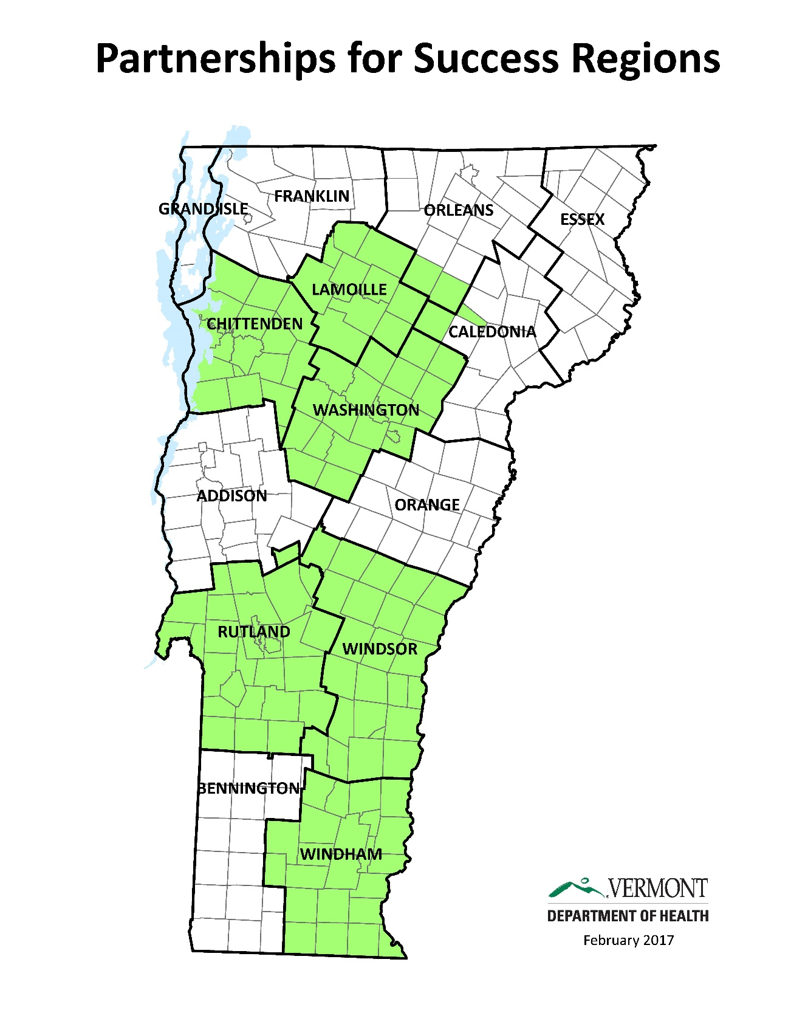

Slide 7
ADAP’s Role
ADAP provided regions with:
  A guidance document which outlined the steps in the Strategic Prevention Framework.
  Regional data profiles which included data on the prevalence, risk and protective factors and consequences of substance use.
  A menu of both required and optional evidence-based interventions and supporting activities to be implemented throughout the region.
  Ongoing training and technical assistance.

Slide 8
Assessment and Planning
A strategic planning process, led by Health District Directors and ADAP Prevention Consultants, was used to:
  examine data,
  assess regional and community resources,
  define the specific geographic area to be served,
  engage community partners and
  select interventions and activities from PFS menu to be implemented.

Slide 9
Assessment and Planning Continued
ADAP approved strategic plans and provided detailed work plans for each intervention utilizing available fidelity guidelines.
In each region, a lead agency was selected to receive the funding and to coordinate the implementation of prevention activities.
Lead agencies hired a coordinator and also sub-granted money to community partners to assist with implementation.
PFS funding for communities began in July 2013 and continued through June 2016.

Slide 10
Vermont PFS Interventions
The interventions menu included interventions and activities at different levels of the Vermont Prevention Model to encourage a comprehensive mix of strategies.
Local policy approaches such as alcohol outlet density control and restrictions on alcohol in public places.
Enhanced enforcement of underage drinking laws
Media advocacy and community mobilization, communications campaigns, expansion of safe drug disposal sites
College-based online prevention education and screening such as Alcohol Edu
Parent education programs that emphasize family connection as a prevention tool
Prevention education for youth
Notes:
Most of the required strategies were at the Policies/Systems and Community levels of the Prevention Model because they are designed to impact a whole population such as youth or parents. These environmental strategies are more likely to lead to population-level changes because they work by changing the social context and community norms that promote healthy behaviors and decrease risky ones. Optional strategies included those that focused on small groups of parents or individual youth or young adults.

Slide 11
Evaluation Data Sources
Process evaluation:
  Community Grantee Reporting System (CGRS)
  Annual site visits
  Qualitative assessment of regional capacity done in summer 2015
Outcome Evaluation:
  YRBS 2013 (baseline) and 2015 (follow-up)
  Young Adult Survey 2014 (baseline) and 2016 (follow-up)

Slide 12
What did grantees do?
Grantees implemented an average of 11 evidence-based interventions and/or supporting activities across their regions.
Required strategies used by all grantees included:
  Education of policymakers and community members on policy options to prevent underage drinking,
  Community mobilization,
  Media advocacy,
  Support of enhanced enforcement of alcohol laws,
  Support of responsible beverage service training,
  Recognition of retailers for passing compliance checks, and
  Education to the community, pharmacists and health care providers about ways to reduce prescription drug misuse.
Additional optional strategies included online alcohol screening and education programs, parent education programs and Sticker Shock.

Slide 13
How well did they do it?
Progress on implementation and other process measures were collected and monitored through an online reporting tool called the Community Grantee Reporting System (CGRS) as well as through annual site visits.
Noteworthy accomplishments by grantees include:
  380,000 Vermonters were potentially exposed to PFS prevention initiatives through population-level interventions (approximately 60% of the state’s population)
  3 new community-level policies designed to reduce underage drinking were enacted.
  8 new permanent drop-off locations were established for the disposal of unused prescription medications.
  636 college students participated in an online alcohol screening and education program (Alcohol Edu).
  194 parents participated in parenting education programs.

Slide 14
Progress on Regional Prevention Structure (PFS Goal #3)
Measured through Focus Groups and Interviews with Health District Directors, PCs, Grantee Coordinators, and Community Partners in Summer of 2015
Successes:
  Increased coordination, networking, and sharing of ideas
  More efficient dissemination of communications campaigns
  Greater reach into underserved communities

Slide 15
Progress on Regional Prevention Structure (PFS Goal #3)
Challenges:
  Understanding the roles and responsibilities of different levels of the regional system
  Maintaining local connections while shifting to a regional lens
  Resources are spread thin

Slide 16
Outcome Evaluation:
Approach
Focus on population-level outcomes
    Sources: YRBS
    Young Adult Survey (YAS)
Examine changes over time in outcome measures in the funded regions
Compare changes in the funded regions to those in the remainder of the state

Slide 17
Timeline
2012
2013
2014
2015
2016
Intervention implementation
PFS begins
PFS ends
YRBS conducted
YAS conducted

Slide 18
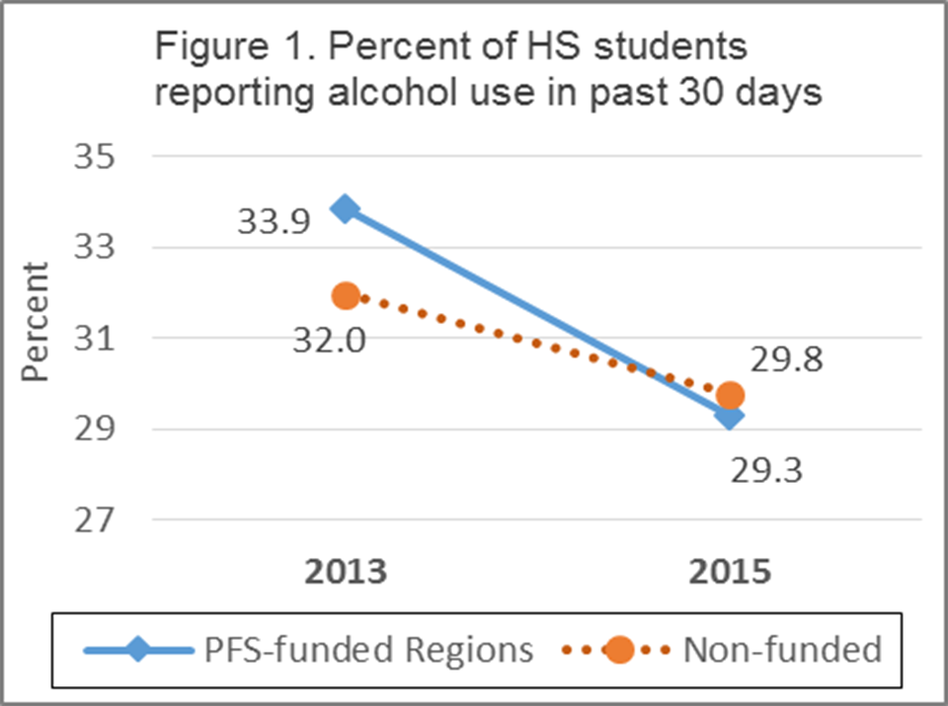
Outcome Evaluation Findings
Goal 1: Reduce underage and binge drinking among persons aged 12 to 20
Source: YRBS
PFS effect was significant at p<.05

Slide 19
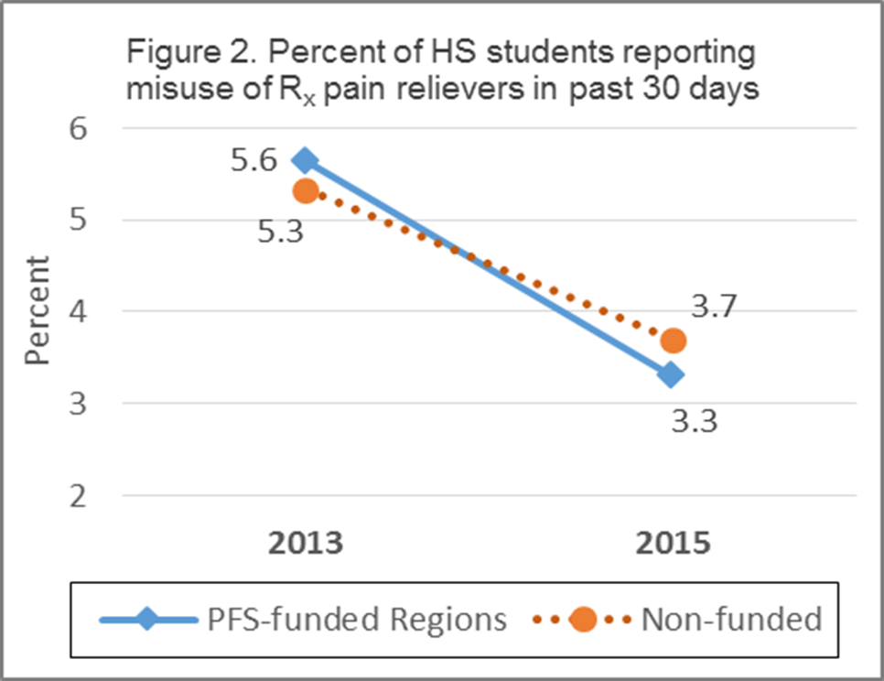
Outcome Evaluation Findings
Goal 2: Reduce prescription drug misuse and abuse among persons aged 12 to 25
Source: YRBS
PFS effect was significant at p<.10

Slide 20
Outcome measures examined (YRBS)
Substance Use Behaviors:
Current alcohol use
Current binge drinking
Lifetime Rx pain reliever misuse
Lifetime Rx stimulant misuse
Current Rx pain reliever misuse (high school only)
Current Rx stimulant misuse (high school only)
Risk Factors:
Perceived ease of obtaining alcohol
Drinking alcohol viewed to be a little bit wrong or not at all wrong
Perception that parents view alcohol use by child is a little bit wrong or not at all wrong
Low perceived risk of harm from binge drinking

Slide 21
Outcome measures examined (YAS)
Substance Use Behaviors:
Current alcohol use
Current binge drinking
Current underage alcohol use
Past year Rx pain reliever misuse
Past year Rx sedative misuse
Past year Rx stimulant misuse
Risk Factors:
Perceived ease of obtaining alcohol:
  from friends or family (by persons 18-20)
  from stores (by persons 18-20)
  in restaurants & bars (by persons 18-20)
Perceived ease of obtaining Rx pain relievers without a prescription
Low perceived risk of harm from binge drinking
Low perceived risk of harm from using R_{x} pain relievers not prescribed

Slide 22
Summary of patterns observed across all outcome measures
Patterns for most outcome measures examined were similar to the two measures plotted earlier (although only a few effects were statistically significant). Specifically:
These patterns generally held for each of the six PFS-funded regions individually
 | Behavioral Measures |  |  | Risk Factors
 | Number | Number that decreased | Number of comps favorable to PFS | Number | Number that decreased | Number of comps favorable to PFS
Middle School | 4 | 3 | 4 | 4 | 3 | 2
High school | 6 | 6 | 6 | 4 | 3 | 4
Young Adult | 6 | 4 | 5 | 6 | 5 | 5
Total | 16 | 13 | 15 | 14 | 11 | 11

Slide 23
Statewide Evaluation Conclusions
  PFS represents a successful transition to a regional-based prevention system in Vermont, although challenges remain to enhance and sustain this approach
  PFS appears to have contributed to regional and statewide reductions in underage drinking and prescription drug misuse among youth and young adult Vermonters

Slide 24
Putting the PFS evaluation findings into the larger context…
To what extent have the PFS and other large federally-funded discretionary grants* for substance abuse prevention contributed to reductions in underage drinking in Vermont over the past 20 years?
* SIG, SPF-SIG, and PFS

Slide 25
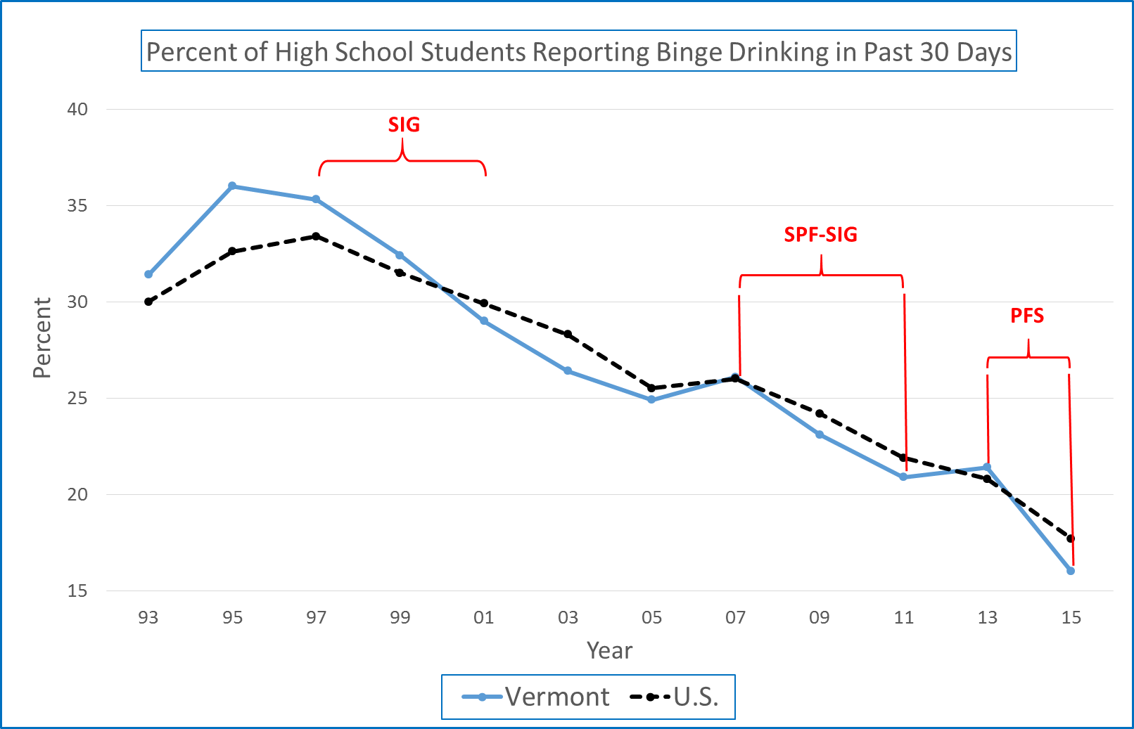

Slide 26
Binge Drinking trend summary: 1993 to 2015 (YRBS: high school)
 |  | Binge drinking rates among high school students: Annual percentage point change from first year to last
Years | Federal Funding | Vermont | U.S. | Comparison to U.S. favors Vermont? | Difference (VT – U.S.)
93 to 97 |  | 0.97 | 0.85 |  | +.13
97 to 01 | SIG | -1.57 | -0.88 | ✓ | -.69
01 to 07 |  | -0.48 | -0.65 |  | +.17
07 to 11 | SPF-SIG | -1.30 | -1.03 | ✓ | -.27
11 to 13 |  | 0.25 | -0.55 |  | +.80
13 to 15 | PFS | -2.70 | -1.55 | ✓ | -1.15

Slide 27
Vermont PFS Evaluation:
Links to reports and tools
ADAP brief (two-page) PFS evaluation summary report:
  ADAP web site (click on Plans and Reports and then PFS Evaluation Summary)
PIRE PFS II Evaluation Report:
  http://www.pire.org/documents/Vermont_PFS_Eval/Final Report.pdf
PIRE PFS Regional Structure Qualitative Study Report:
  http://healthvermont.gov/alcohol-drugs/reports/data-and-reports
YAS survey (list of all items):
  http://www.pire.org/documents/Vermont_PFS_Eval/YAS questions 2016.pdf
YAS 2014 summary report:
  http://www.healthvermont.gov/sites/default/files/documents/2016/12/ADAP_VT_PFS_YAS_Summary_Report.pdf

Slide 28

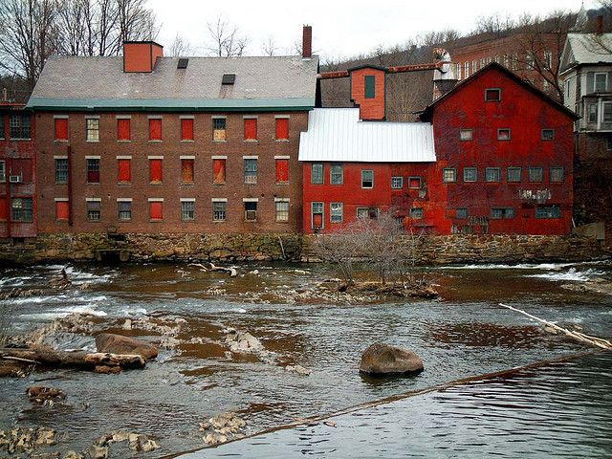
PFS II: Implementation at the Regional Level

Slide 29
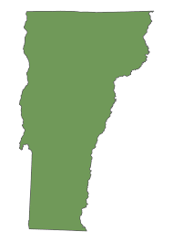
Previous Funding Structure – SPF-SIG
SPF-SIG:
Grants of $50,000 - $125,000 PER coalition
22 coalitions funded in the state

Slide 30
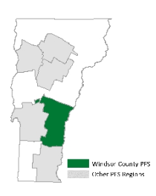
PFS II
$125,000 for region
Focus to include non-traditional partners
Lead agent to coordinate the region
Windsor County:
  23 towns,
  population 55,000,
  contained 5 existing local prevention coalitions

Slide 31
Our Mantra
“This money is not for funding coalitions,
it is for funding strategies”

Slide 32
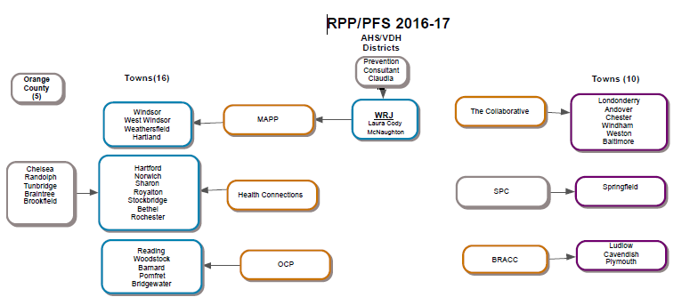
PFS II: Coaltion Structure

Slide 33
PFS II: Committee Structure

Slide 34

What next?
Vermont’s Regional Prevention Partnerships (RPP) continues funding to PFS-funded regions and is also funding 6 new lead agencies, under Vermont’s PFS 2015 grant.

Slide 35
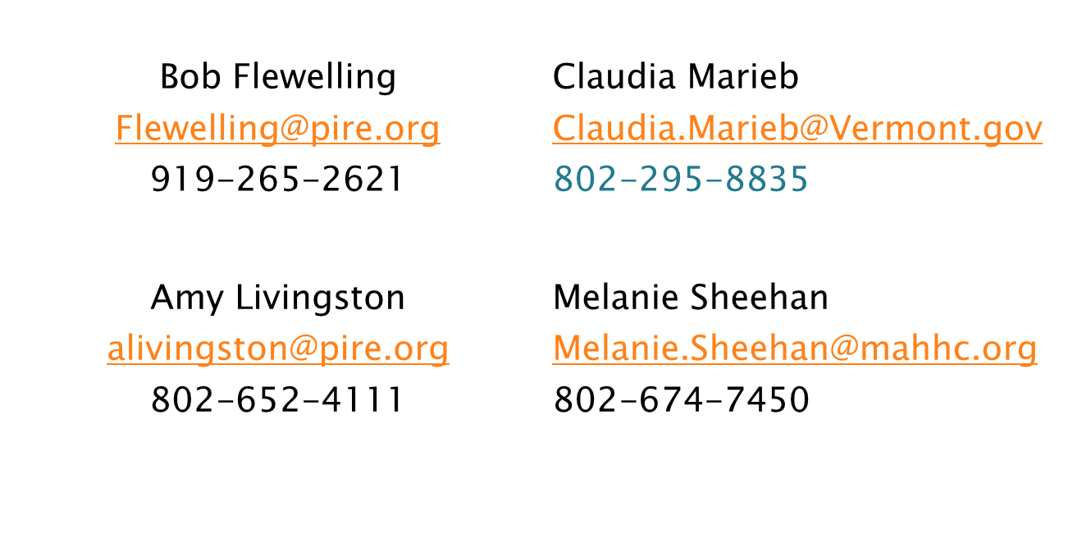
Contact Information

Slide 36





www.npnconference.org
After the conference, please complete online evaluations that you will receive via email.
facebook.com/npnconference2017
@NPNconference

